Slide 1




Large-scale Clustering for Big Data Analytics: A MapReduce Implementation of Hierarchical Affinity Propagation
Dillon Mark Rose
Jean Michel Rouly
Rana Haber
Nenad Mijatovic
Dr. Adrian M. Peter
Notes:
Names
Large-scale Clustering for Big Data Analytics: A MapReduce Implementation of Hierarchical Affinity Propagation

Slide 2
Project Goal
To develop a robust data mining framework
in a cloud-computing environment capable of processing massive quantities of information for the extraction of actionable intelligence

Slide 3
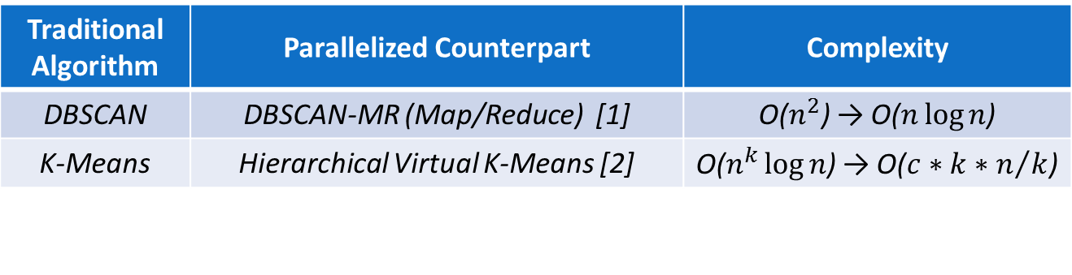
Motivation
Traditional clustering algorithms fall short of meeting the high throughput demands of big data processing.
Traditional Algorithm | Parallelized Counterpart | Complexity
DBSCAN | DBSCAN-MR (Map/Reduce) [1] | O($n^{2}$) → O($n\log{n}$)
K-Means | Hierarchical Virtual K-Means [2] | O($n^{k}\log{n}$) → O($c∗k∗n/k$)
[1] Dai and Lin, 2012
[2] Nair and Madhuri, 2011

Slide 4
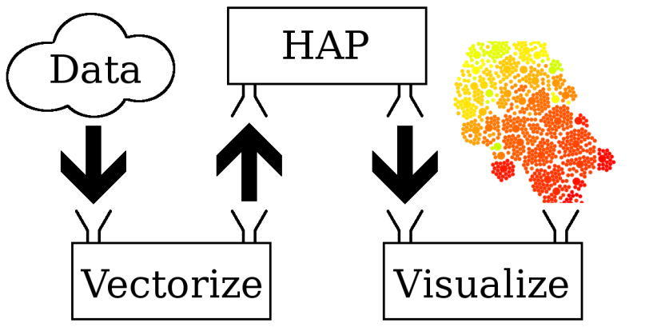
Data Flow

Slide 5





Acquire Data
Modality:
  Images
  Text
  Real valued
  etc.

Slide 6
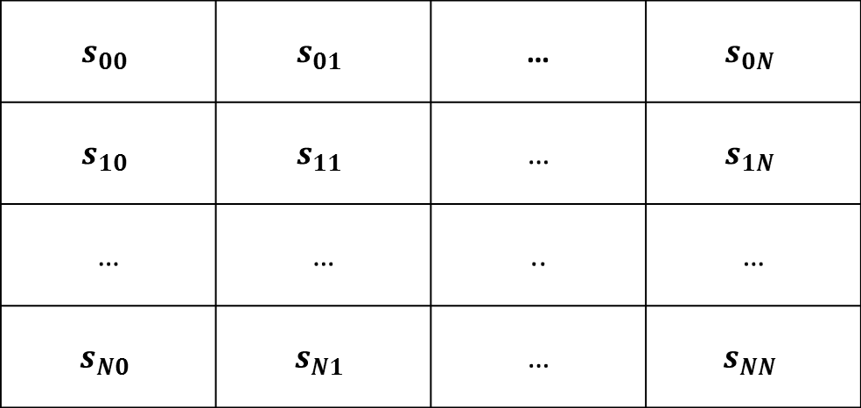
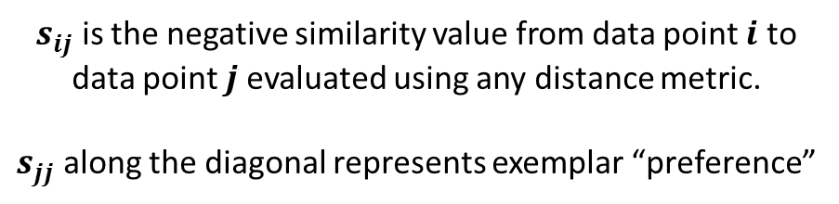
Mathematical Representation
Similarity Matrix (data modality independent)
$$s_{00}$$ | $$s_{01}$$ | … | $$s_{0N}$$
$$s_{10}$$ | $$s_{11}$$ | … | $$s_{1N}$$
… | … | .. | …
$$s_{N0}$$ | $$s_{N1}$$ | … | $$s_{NN}$$
$s_{ij}$ is the negative similarity value from data point $i$ to
data point $j$evaluated using any distance metric.
$s_{jj}$ along the diagonal represents exemplar “preference”
Notes:
Talk about Modality Point

Slide 7

Affinity Propagation (Frey and Dueck, 2007)
Input: Similarity Matrix ( N x N )
Output: Clusters of Data
Responsibility Update ($ρ$)
Availability Update ($α$)

Slide 8
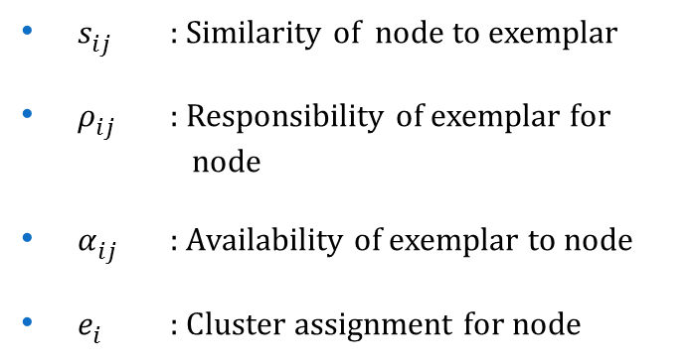
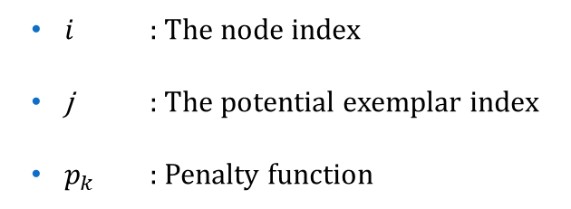
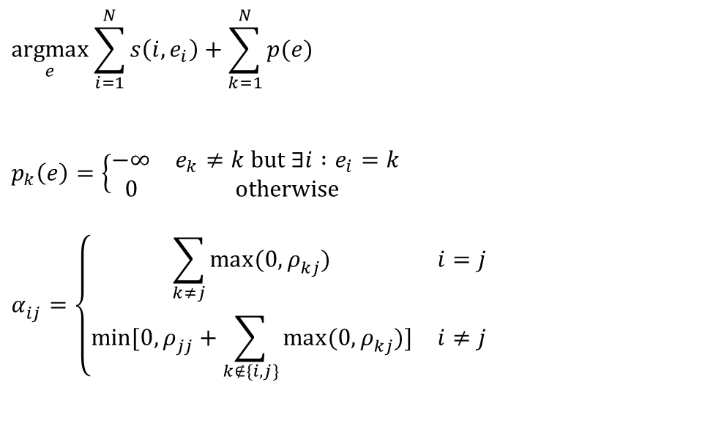
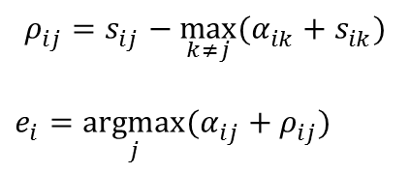
Affinity Propagation (Frey and Dueck, 2007)
$i$ : The node index
j : The potential exemplar index
$p_{k}$ : Penalty function
$s_{ij}^{}$ : Similarity of node to exemplar
$ρ_{ij}^{}$ : Responsibility of exemplar for node
$α_{ij}^{}$ : Availability of exemplar to node
$e_{i}^{}$ : Cluster assignment for node
$$\underset{e}{argmax}\sum_{i=1}^{N}{s\left(i,e_{i}\right)}+\sum_{k=1}^{N}{p(e)}$$
$$p_{k}\left(e\right)=\left\{\begin{matrix}−∞ & e_{k}≠k \text{but} ∃i :e_{i}=k \\ 0 & \text{otherwise}\end{matrix}\right.$$
$$α_{ij}^{}=\left\{\begin{matrix}\sum_{k≠j}{\max_{ }{(0,ρ_{kj}^{})}} & i=j \\ \min_{ }{[0,}ρ_{jj}^{}+\sum_{k∉\{i,j\}}{\max_{ }{(0,ρ_{kj}^{})}]} & i≠j\end{matrix}\right.$$
$$ρ_{ij}^{}=s_{ij}^{}−\max_{k≠j}{(α_{ik}^{}+s_{ik}^{})}$$
$$e_{i}^{}=\underset{j}{argmax}{(α_{ij}^{}+ρ_{ij}^{})}$$

Slide 9

Hierarchical Affinity Propagation
(Givoni, Chung, and Frey, 2007)
Input: Similarity Matrix ( N x N ) and Number of Levels
Output: Hierarchy of Clusters
Responsibility Update ($ρ$)
Availability Update ($α$)
Phi Update ($φ$)
Tao Update ($τ$)
Level 3
Level 2
Level 1

Slide 10
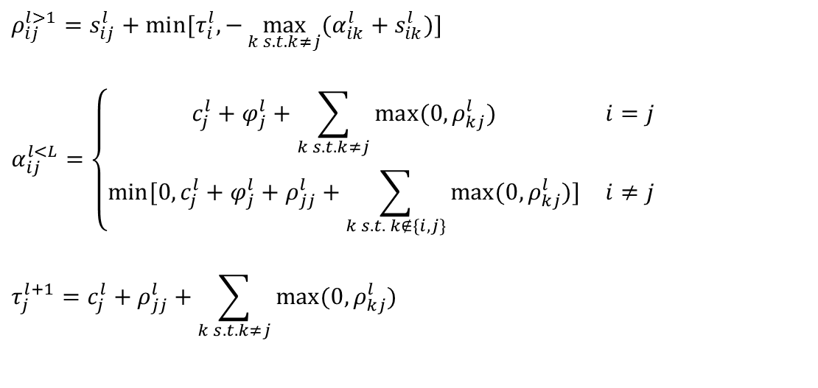
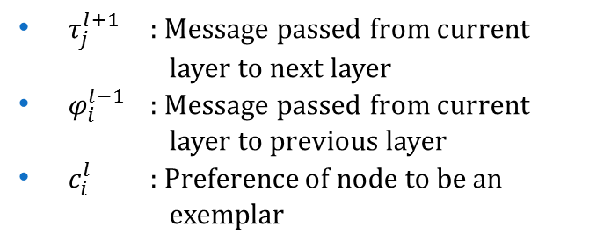
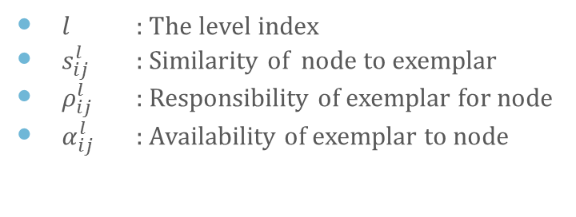
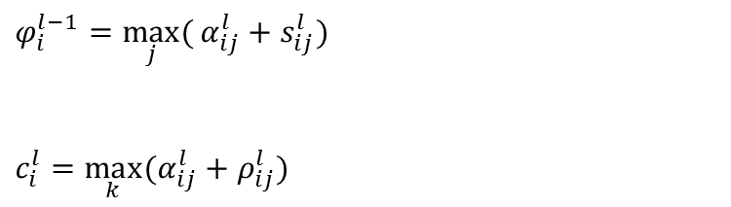
Hierarchical Affinity Propagation
(Givoni, Chung, and Frey, 2007)
$l$ : The level index
$s_{ij}^{l}$ : Similarity of node to exemplar
$ρ_{ij}^{l}$ : Responsibility of exemplar for node
$α_{ij}^{l}$ : Availability of exemplar to node
$τ_{j}^{l+1}$ : Message passed from current layer to next layer
$φ_{i}^{l−1}$ : Message passed from current layer to previous layer
$c_{i}^{l}$ : Preference of node to be an exemplar
$ρ_{ij}^{l>1}=s_{ij}^{l}+min⁡[τ_{i}^{l},−\max_{k s.t. k≠j}{(α_{ik}^{l}+s_{ik}^{l})}$]
$$α_{ij}^{l<L}=\left\{\begin{matrix}c_{j}^{l}+φ_{j}^{l}+\sum_{k s.t. k≠j}{\max_{ }{(0,ρ_{kj}^{l})}} & i=j \\ \min_{ }{[0,}c_{j}^{l}+φ_{j}^{l}+ρ_{jj}^{l}+\sum_{k s.t. k∉\{i,j\}}{\max_{ }{(0,ρ_{kj}^{l})}]} & i≠j\end{matrix}\right.$$
$$τ_{j}^{l+1}=c_{j}^{l}+ρ_{jj}^{l}+\sum_{k s.t. k≠j}{\max_{ }{(0,ρ_{kj}^{l})}}$$
$$φ_{i}^{l−1}=\max_{j}{(}α_{ij}^{l}+s_{ij}^{l})$$
$$c_{i}^{l}=\max_{k}{(α_{ij}^{l}+ρ_{ij}^{l})}$$

Slide 11

Analytics
Apache Hadoop
  Open source framework
  Distributed processing of Big Data
  Implements MapReduce paradigm
    Map
    Shuffle
    Reduce

Slide 12
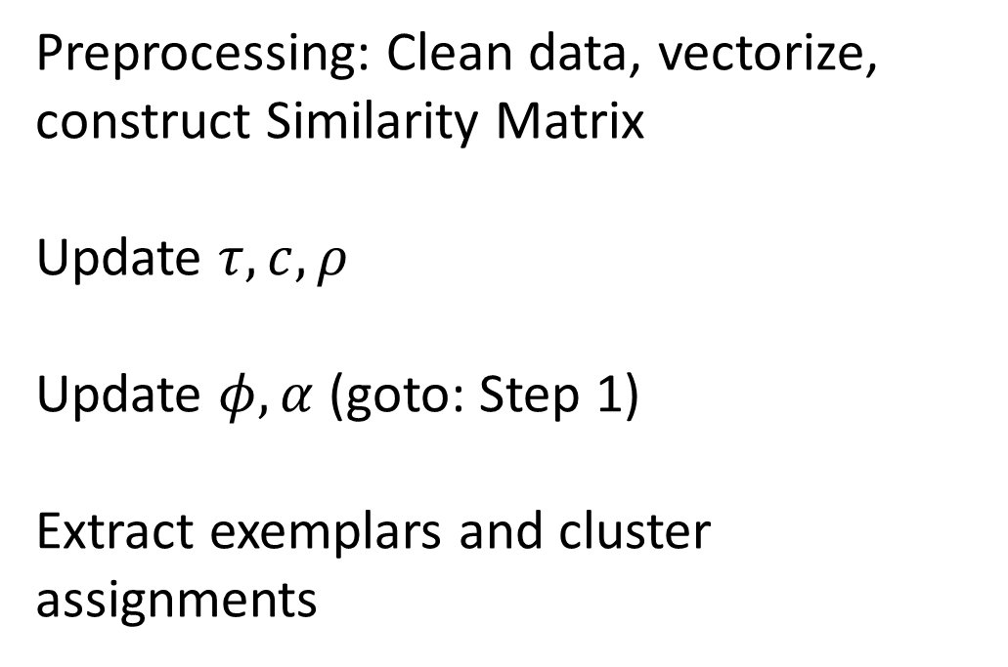
Parallelization Scheme Overview
[Step 0]
[Step 1]
[Step 2]
[Step3]
Preprocessing: Clean data, vectorize, construct Similarity Matrix
Update $τ, c, ρ$
Update $φ, α$ (goto: Step 1)
Extract exemplars and cluster assignments

Slide 13
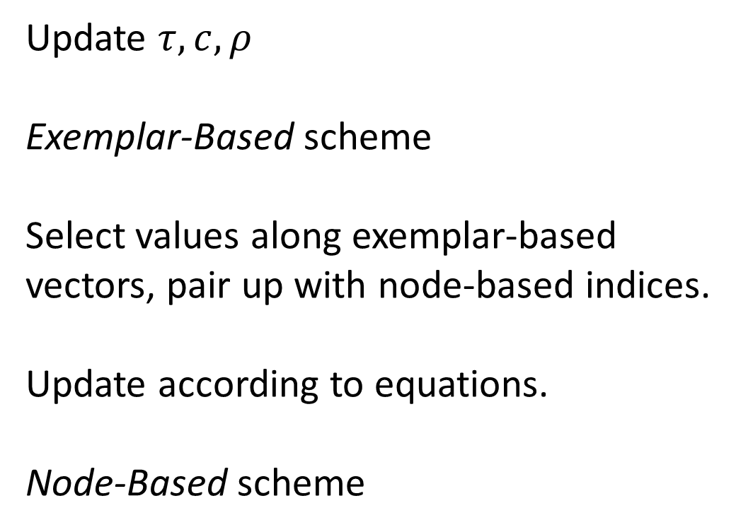
Parallelization Scheme [Step 1]
[Step 1]
[Input]
[Map]
[Reduce]
[Output]
Update $τ, c, ρ$
Exemplar-Based scheme
Select values along exemplar-based vectors, pair up with node-based indices.
Update according to equations.
Node-Based scheme

Slide 14
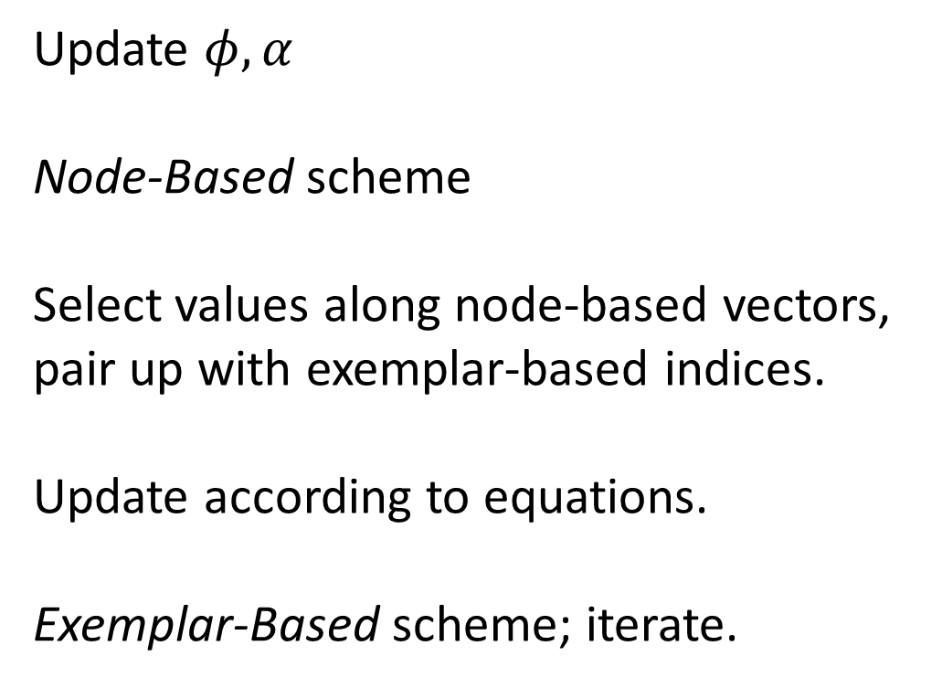
Parallelization Scheme [Step 2]
[Step 2]
[Input]
[Map]
[Reduce]
[Output]
Update $φ, α$
Node-Based scheme
Select values along node-based vectors, pair up with exemplar-based indices.
Update according to equations.
Exemplar-Based scheme; iterate.

Slide 15
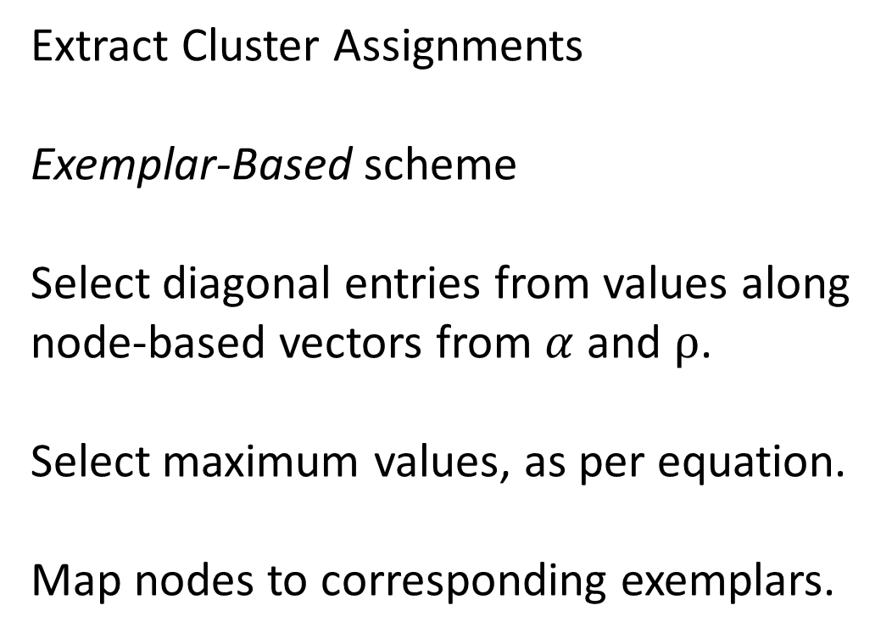
Parallelization Scheme [Step 3]
[Step 3]
[Input]
[Map]
[Reduce]
[Output]
Extract Cluster Assignments
Exemplar-Based scheme
Select diagonal entries from values along node-based vectors from $α$ and $ρ$.
Select maximum values, as per equation.
Map nodes to corresponding exemplars.

Slide 16
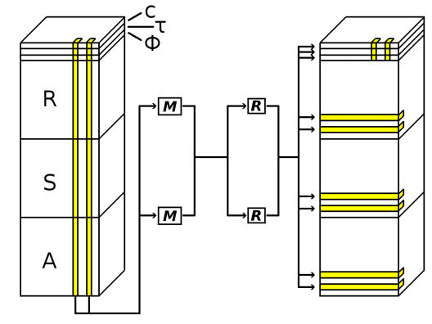
Parallelization Scheme Diagram

Slide 17
Complexity
k = Number of Iterations
L = Number of Levels
N = Dimensions of Matrix
M = Number of Parallel Machines
AP Sequential | AP MapReduce
Average Case : O ( k N² ) Best Case : O ( k N² ) | Average Case : O ( k N² / M ) Best Case : O ( k N )
HAP Sequential | HAP MapReduce
Average Case : O ( k L N² ) Best Case : O ( k L N² ) | Average Case : O ( k L N² / M ) Best Case : O ( k N )

Slide 18


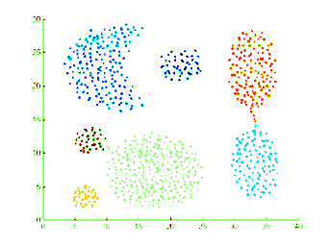

Experiments
Images
  Mandrill (128x128) = 16,384 points
  Buttons (120x100) = 12,000 points
Text
  Newspaper Articles
Synthetic Data
  Shapes (788)
  4 sets from Gaussian Distribution (2,000)

Slide 19
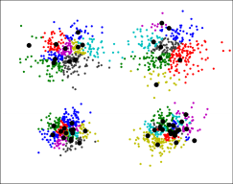
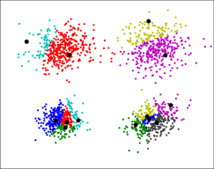
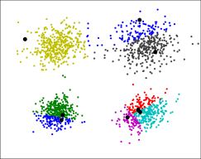
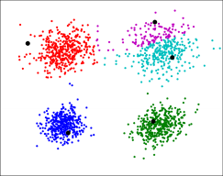
Results
Fig 1: 51 clusters
Fig 2: 13 clusters
Fig 3: 8 clusters
Fig 4: 5 clusters
Clustering within each level of the output hierarchy.

Slide 20




Mandrill Dataset
Fig 1: Original Image
Fig 2: 15 clusters
Fig 3: 7 clusters
Fig 4: 6 clusters

Slide 21
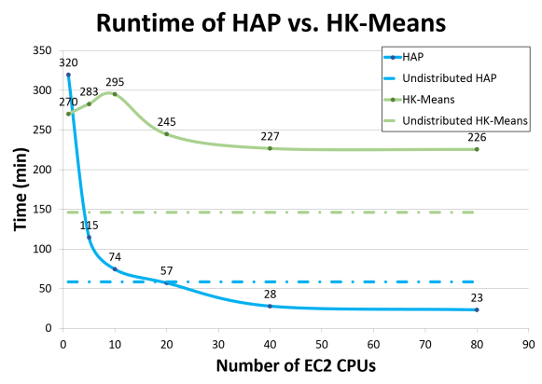

Runtime

Slide 22
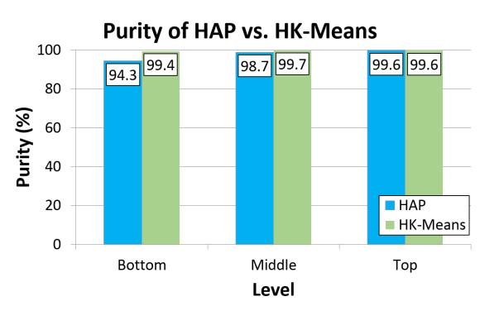
Purity

Slide 23
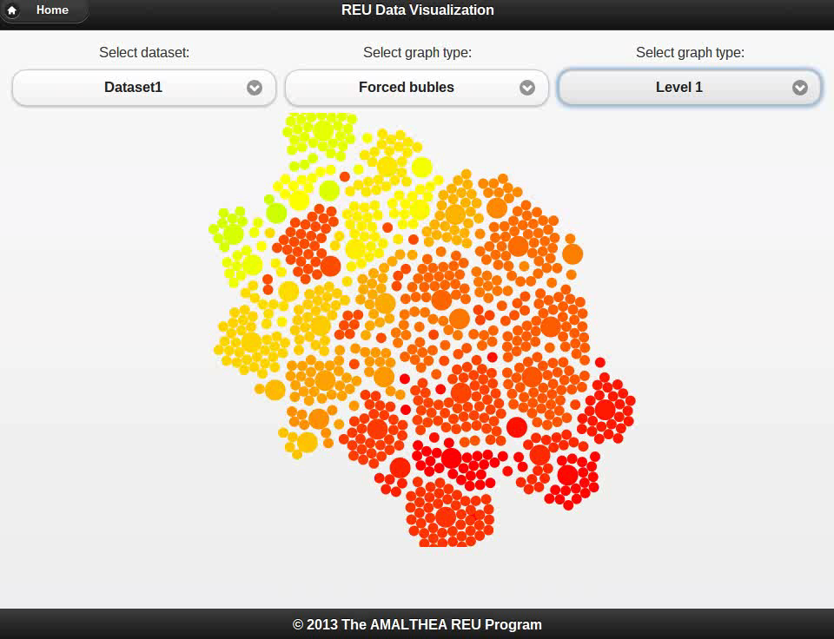
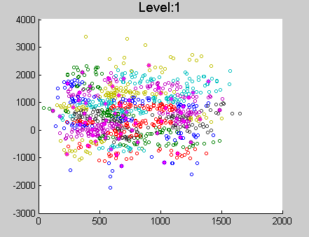
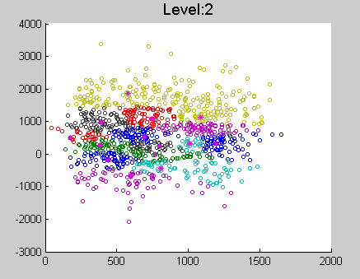
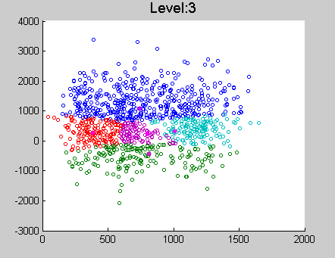
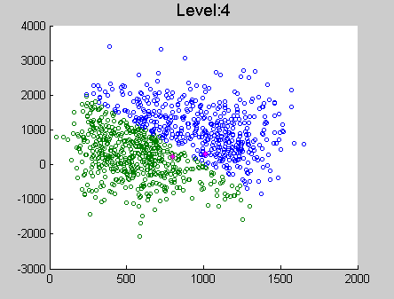
Visualization

Slide 24



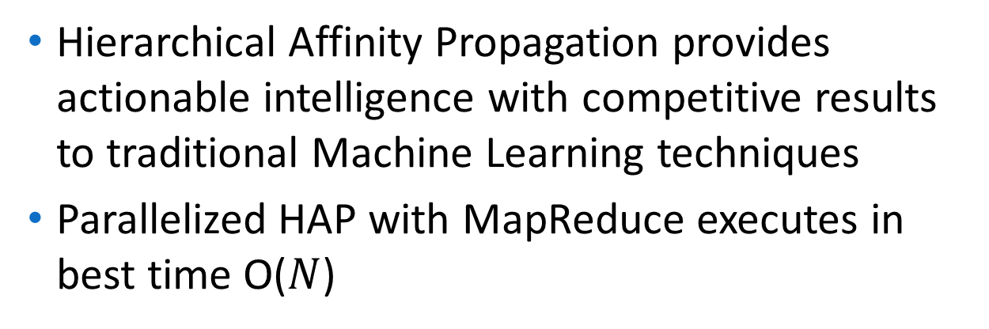
Summary
Hierarchical Affinity Propagation provides actionable intelligence with competitive results to traditional Machine Learning techniques
Parallelized HAP with MapReduce executes in best time O($N$)
Code available for download / preview:
research2.fit.edu/ice
github.com/jrouly/hap-with-map
michel.rouly.net/work.html

Slide 25
References
Clustering by Passing Messages Between Data Points.
Brendan J. Frey and Delbert Dueck
Science 315, 972 – 976, Feb 2007
OSDI'04 Proceedings of the 6th conference on Symposium on Operating Systems. Design & Implementation
Volume 6 Pages 10 - 10
Hierarchical Affinity Propagation.
Inmar E. Givoni, Clement Chung, and Brendan J. Frey
arXiv preprint arXiv 1202. 3722 (2012)
T. Nair and K. Madhuri, “Data mining using hierarchical virtual k-means approach integrating data fragments in cloud computing environment,” in IEEE CCIS , 2011, pp. 230–234.
B. R. Dai and I. C. Lin, “Efficient map/reduce-based DBSCAN algorithm with optimized data partition,” in IEEE CLOUD, 2012, pp. 59–66.
Apache, Apache Hadoop Apache Mahout, Hadoop, Mahout, the Hadoop logo, and the Mahout logo are trademarks of The Apache Software Foundation. Amazon Web Services, the “Powered by Amazon Web Services” logo, and the "Amazon Web Services" logo are trademarks of Amazon.com, Inc. or its affiliates in the United States and/or other countries. Used with permission. No endorsement by The Apache Software Foundation or Amazon.com, Inc. is implied by the use of these marks.

Slide 26
Appendix

Slide 28
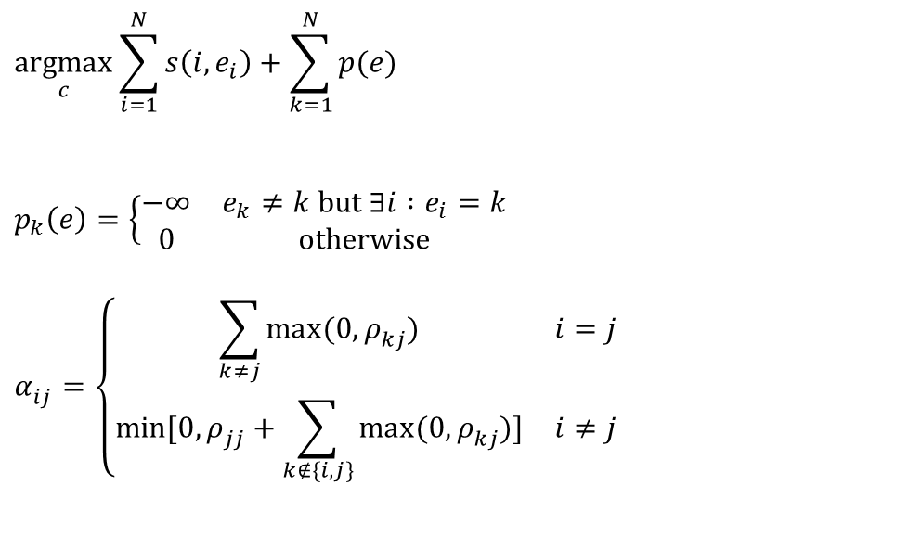
Affinity Propagation
$i$ : The node index
j : The potential exemplar index
$p_{k}$ : Penalty function
$s_{ij}^{}$ : Similarity of node to exemplar
$ρ_{ij}^{}$ : Responsibility of exemplar for node
$α_{ij}^{}$ : Availability of exemplar to node
$e_{i}^{}$ : Cluster assignment for node
$$\underset{c}{argmax}\sum_{i=1}^{N}{s\left(i,e_{i}\right)}+\sum_{k=1}^{N}{p(e)}$$
$$p_{k}\left(e\right)=\left\{\begin{matrix}−∞ & e_{k}≠k \text{but} ∃i :e_{i}=k \\ 0 & \text{otherwise}\end{matrix}\right.$$
$$α_{ij}^{}=\left\{\begin{matrix}\sum_{k≠j}{\max_{ }{(0,ρ_{kj}^{})}} & i=j \\ \min_{ }{[0,}ρ_{jj}^{}+\sum_{k∉\{i,j\}}{\max_{ }{(0,ρ_{kj}^{})}]} & i≠j\end{matrix}\right.$$
$$ρ_{ij}^{}=s_{ij}^{}−\max_{k≠j}{(α_{ik}^{}+s_{ik}^{})}$$
$$e_{i}^{}=\underset{j}{argmax}{(α_{ij}^{}+ρ_{ij}^{})}$$

Slide 29
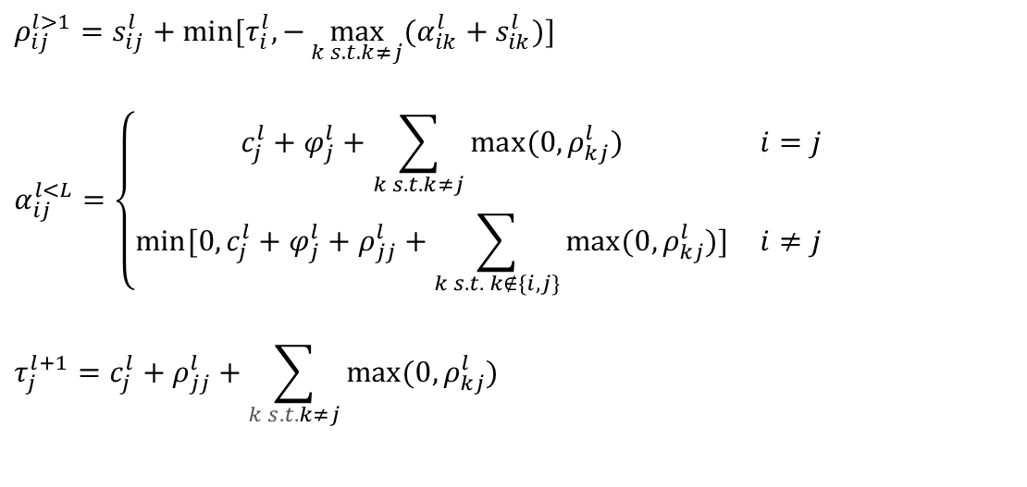
Hierarchical Affinity Propagation
$l$ : The level index
$s_{ij}^{l}$ : Similarity of node to exemplar
$ρ_{ij}^{l}$ : Responsibility of exemplar for node
$α_{ij}^{l}$ : Availability of exemplar to node
$τ_{j}^{l+1}$ : Message passed from current layer to next layer
$φ_{i}^{l−1}$ : Message passed from current layer to previous layer
$c_{i}^{l}$ : Preference of node to be an exemplar
$ρ_{ij}^{l>1}=s_{ij}^{l}+min⁡[τ_{i}^{l},−\max_{k s.t. k≠j}{(α_{ik}^{l}+s_{ik}^{l})}$]
$$α_{ij}^{l<L}=\left\{\begin{matrix}c_{j}^{l}+φ_{j}^{l}+\sum_{k s.t. k≠j}{\max_{ }{(0,ρ_{kj}^{l})}} & i=j \\ \min_{ }{[0,}c_{j}^{l}+φ_{j}^{l}+ρ_{jj}^{l}+\sum_{k s.t. k∉\{i,j\}}{\max_{ }{(0,ρ_{kj}^{l})}]} & i≠j\end{matrix}\right.$$
$$τ_{j}^{l+1}=c_{j}^{l}+ρ_{jj}^{l}+\sum_{k s.t. k≠j}{\max_{ }{(0,ρ_{kj}^{l})}}$$
$$φ_{i}^{l−1}=\max_{j}{(}α_{ij}^{l}+s_{ij}^{l})$$
$$c_{i}^{l}=\max_{k}{(α_{ij}^{l}+ρ_{ij}^{l})}$$

Slide 30

Hierarchical Affinity Propagation
Level 3
Level 2
Level 1
Responsibility Update ($ρ$)
Availability Update ($α$)
Phi Update ($φ$)
Tao Update ($τ$)

Slide 31
Parallelization Scheme

